Slide 1


ODEYEMI IBUKUN AKINOLA
25th November, 2021

Slide 2

Outline
Executive Summary – page 3
Introduction – page 4
Methodology – pages 5 - 15
Results – pages 16 - 44
Conclusion - page 45
Appendix – page 46

Slide 3
Executive Summary
The goal of this data science project is to determine the reusability of SpaceX’s Falcon 9 first stage with certainty so as to minimize cost.
EDA, data visualization, predictive methodologies including pandas, numpy, SQL, matplotlib, seaborn, folium, plotly dash, logistic regression, SVM, decision tree, and KNN were employed to determine to reusability falcon-9’s first stage.
The overall reusability of falcon-9’s first stage is 66.67%. KSC LC-39A is the only launch site with higher success ratio of 76.9%, and the booster version with higher success ratio is FT.
The reusability success rate increased gradually between year 2010 and 2020, and it is likely to continue to increase in the nearer future

Slide 4
Introduction
Project background and context
This project aimed to analyze SpaceX’s Falcon 9 rocket launches. The goal is to predict if Falcon-9’s first stage would land successfully after being launched into space. By determining the successful landing of Falcon-9’s stage, we could determine the launching cost of the rocket. By reusing the first stage of Falcon 9, the launching cost per rocket would surely reduce from 165 million to approximately 63 millions. This finding made SpaceX’s space program relatively cheaper compared to other providers.
Problems you want to find answers
Which factors contribute to successful landing?
Which conditions will aid SpaceX to achieve best results?

Slide 5


Slide 6
Methodology
Executive Summary
Data collection methodology:
Request SpaceX’s Restful API to obtain launch data, and applied data cleaning techniques
Perform data wrangling
Finding data patterns using Pandas and Numpy python libraries.
Perform exploratory data analysis (EDA) using visualization and SQL
Perform interactive visual analytics using Folium and Plotly Dash
Perform predictive analysis using classification models
Organize data into classes; class 1 for successful landing, and class 0 for unsuccessful landing.
Standardize and fit the data, split the data into training set and testing set.

Slide 7
Data Collection
➢ Extract data from Wikipedia URL.
➢ Use BeatifulSoup to extract data from tables.
➢ Organize data into dictionary of columns
➢ Map all column dictionaries into dataframe.
➢ Display dataframe and save the data into file.
GitHub URL link: https://github.com/atkinxx/spaceY/blob/main/web%20scraping.ipynb

Slide 8
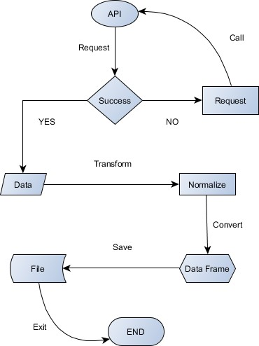
Data Collection – SpaceX API
Present API Call: spacex_url="https://api.spacexdata.com/v4/launches/past"
• response = requests.get(spacex_url)
• data = pd.json_normalize(response.json())
• GitHub URL link: https://github.com/atkinxx/spaceY/blob/main/data%20api.ipynb

Slide 9
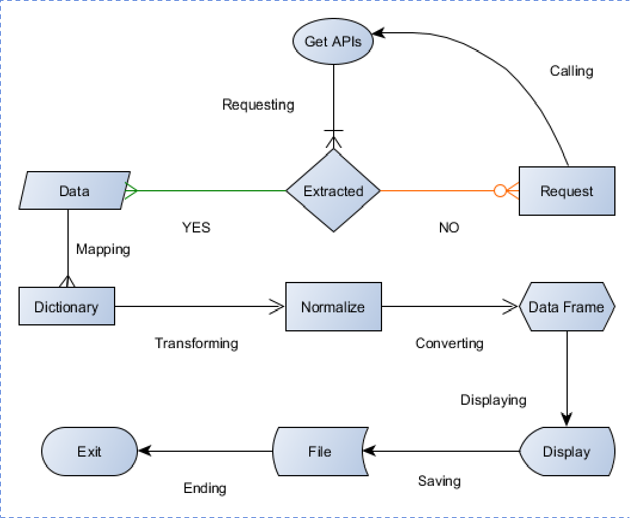
Data Collection - Scraping
Extract data from Wikipedia URL.
Use BeatifulSoup to extract data from tables.
Organize data into dictionary of columns
Map all column dictionaries into dataframe.
Display dataframe and save the data into file.
GitHub URL link: https://github.com/atkinxx/spaceY/blob/main/web%20scraping.ipynb

Slide 10
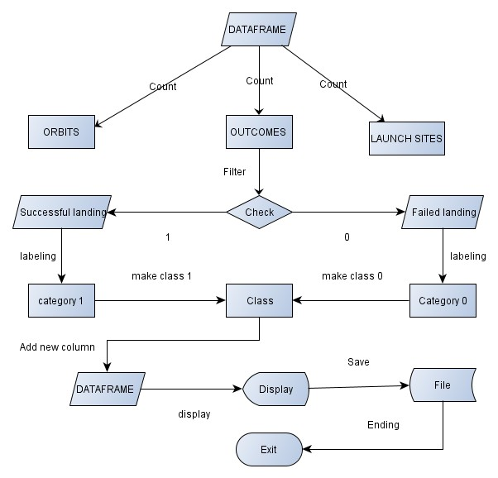
Data Wrangling
From data, count the number of launches per launch site.
From data, count the number of launches into each orbit.
From data, count the number of landing outcome from each launch.
Filter landing outcomes into successful or failed landing.
Create a class of landing outcomes by mapping 1 for successful landing, and 0 for failed landing.
Create a new column of dataframe named class and save the file.
GitHub URL link: https://github.com/atkinxx/spaceY/blob/main/EDA.ipynb

Slide 11
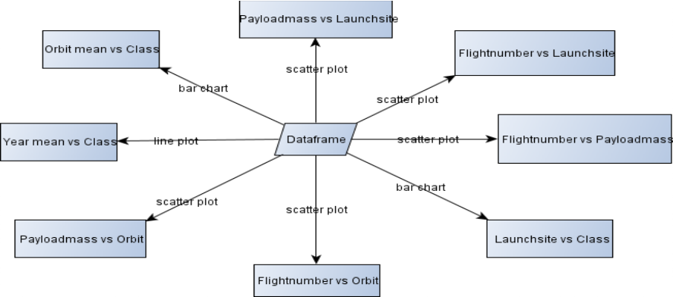
EDA with Data Visualization
Plot Flightnumber vs Payloadmass using scatter.
• Plot Flightnumber vs Launchsite using scatter.
• Plot Payloadmass vs Launchsite using scatter.
• Plot Orbit mean vs Class using bar chart.
• Plot Flightnumber vs Orbit, and Payloadmass vs Orbit using scatter plot.
• Plot Year mean vs Class using line plot.
• GitHub URL link: https://github.com/atkinxx/spaceY/blob/main/EDA%20WITH%20MATPLOT.ipynb

Slide 12
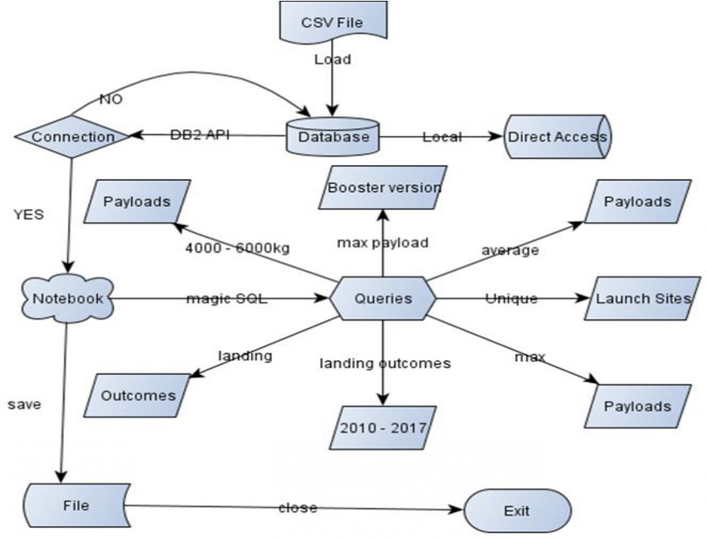
EDA with SQL
Load csv data into db2 database.
• Connect database with notebook and execute SQL magic queries.
• Select unique launch sites, total and average payload per launch.
• Select successful ground landing outcome.
• Select payload between 4000 and 6000 in drone ship landing.
• Select booster version carrying maximum payload into space.
• Count total landing outcomes between year 2010 to 2017.
• GitHub URL link: https://github.com/atkinxx/spaceY/blob/main/EDA%20with%20%20SQL.ipynb

Slide 13
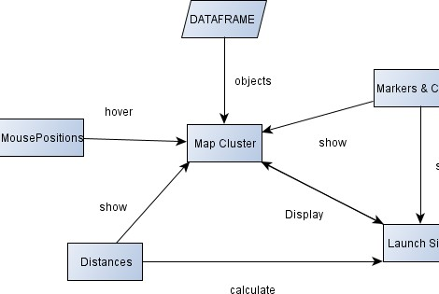
Build an Interactive Map with Folium
Marks all launch sites on global map.
• Display success vs failure launches per each launch site on map.
• Calculate distances between launch site to its closer proximity.
• Add mouse position to display the coordinates.
• GitHub URL link: https://github.com/atkinxx/spaceY/blob/main/Dashboard%20with%20Folium.ipynb

Slide 14
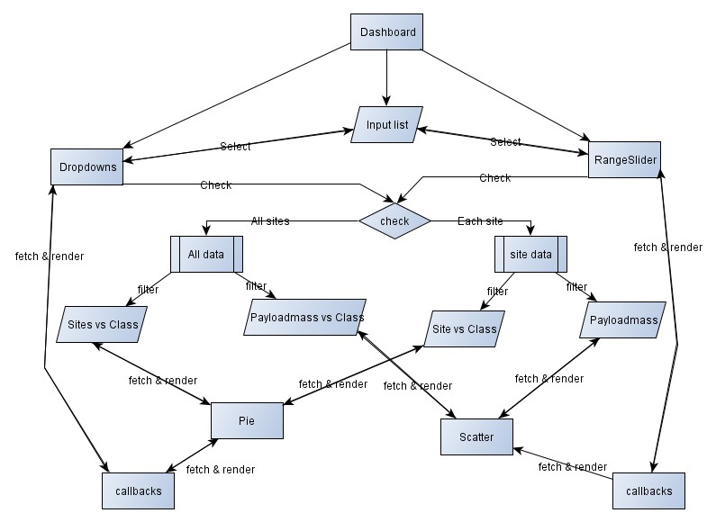
Build a Dashboard with Plotly Dash
➢ Add title of dashboard, dropdown containing list of launch sites.
➢ Add callback function for dropdown to display pie chart if all sites or specific launch site is selected.
➢ Calculate percentage of successful launches of all sites or each site based on dropdown input value.
➢ Add range-slider callbacks function to display scatter plot output if all sites, specific site is selected, or when specific range-slider is pick.
➢ Calculate scatter output based on the range-slider and dropdown inputs of selected site.
• GitHub URL link for basic dashboard app: https://github.com/atkinxx/spaceY/blob/main/spacex_dash_app.py

Slide 15
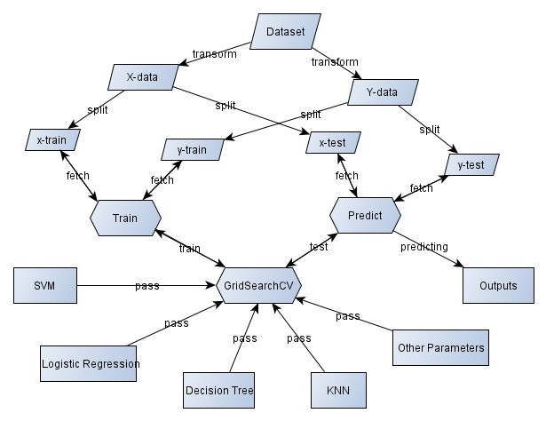
Predictive Analysis (Classification)
➢ Split data into X and Y data sets, fit and transform X data set.
➢ Split X data into x-train and x-test, and split Y data into y-train and y-test.
➢ Build logistic regression, pass it to GridSearchCV, train model using training datasets, and test mode using testing datasets.
➢ Build SVM, pass it to GridSearchCV, train model using training datasets, and test mode using testing datasets.
➢ Build decision tree, pass it to GridSearchCV, train model using training datasets, and test mode using testing datasets.
➢ Build KNN, pass it to GridSearchCV, train model using training datasets, and test mode using testing datasets.
• GitHub URL link: https://github.com/atkinxx/spaceY/blob/main/Predictive%20Analysis.ipynb

Slide 16
Results
➢ The average of reusability success rate is 66.67%.
➢ Site KSC LC 39A has launches success rate of 77% followed by CCAFS SLC-40 with 43% success rate.
➢ Site VAFB SLC-4E has success rate of 40% followed by CCAFS LC-40 with success rate of 27%.
➢ Much of reusability success rate occurred to rockets having payload mass between 1950 -5200 kg.
➢ Much of reusability success rate occurred to rockets having booster version of FT.
➢ Much of reusability success rate occurred in ES-LI, GEO, HEO, and SEO orbits.
➢ Much of reusability success rate increased between 2013 to 2020.
➢ All launch sites are located closer to Equator, they have closest proximities to coastlines, and they’re quite from cities
➢ Logistic regression has a reusability prediction best-score of 84.64% and accuracy of 83.33%.
➢ Support Vector machine has a reusability prediction best-score of 84.82% and accuracy of 83.33%..
➢ Decision tree has a reusability prediction best-score of best-score of 87.68% and accuracy of 66.67%.
➢ K nearest neighbors has a reusability prediction best-score of 84.82% and accuracy of 83.33%.

Slide 17


Slide 18
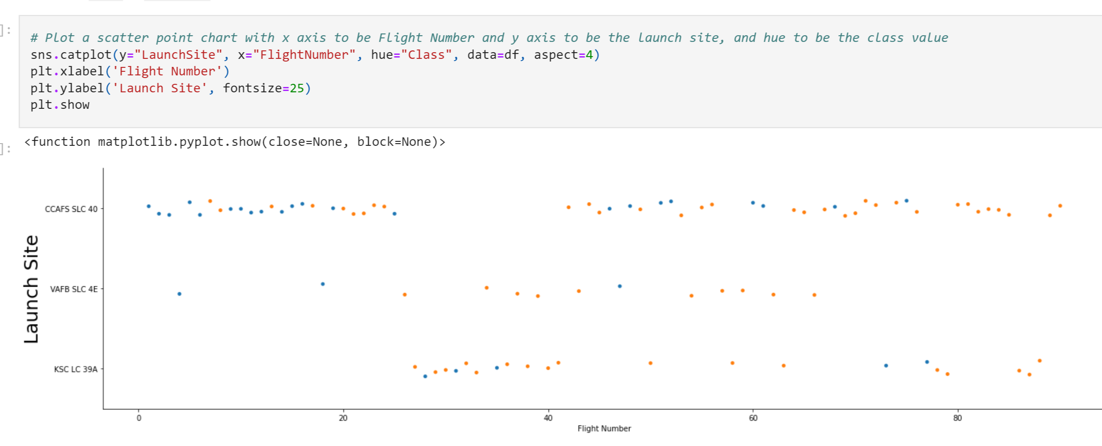
Flight Number vs. Launch Site
For the three sites, CCAFS SLC 40, VAFB SLC 4E , KSC LC 39A- Success rate went up with increased number of flights

Slide 19
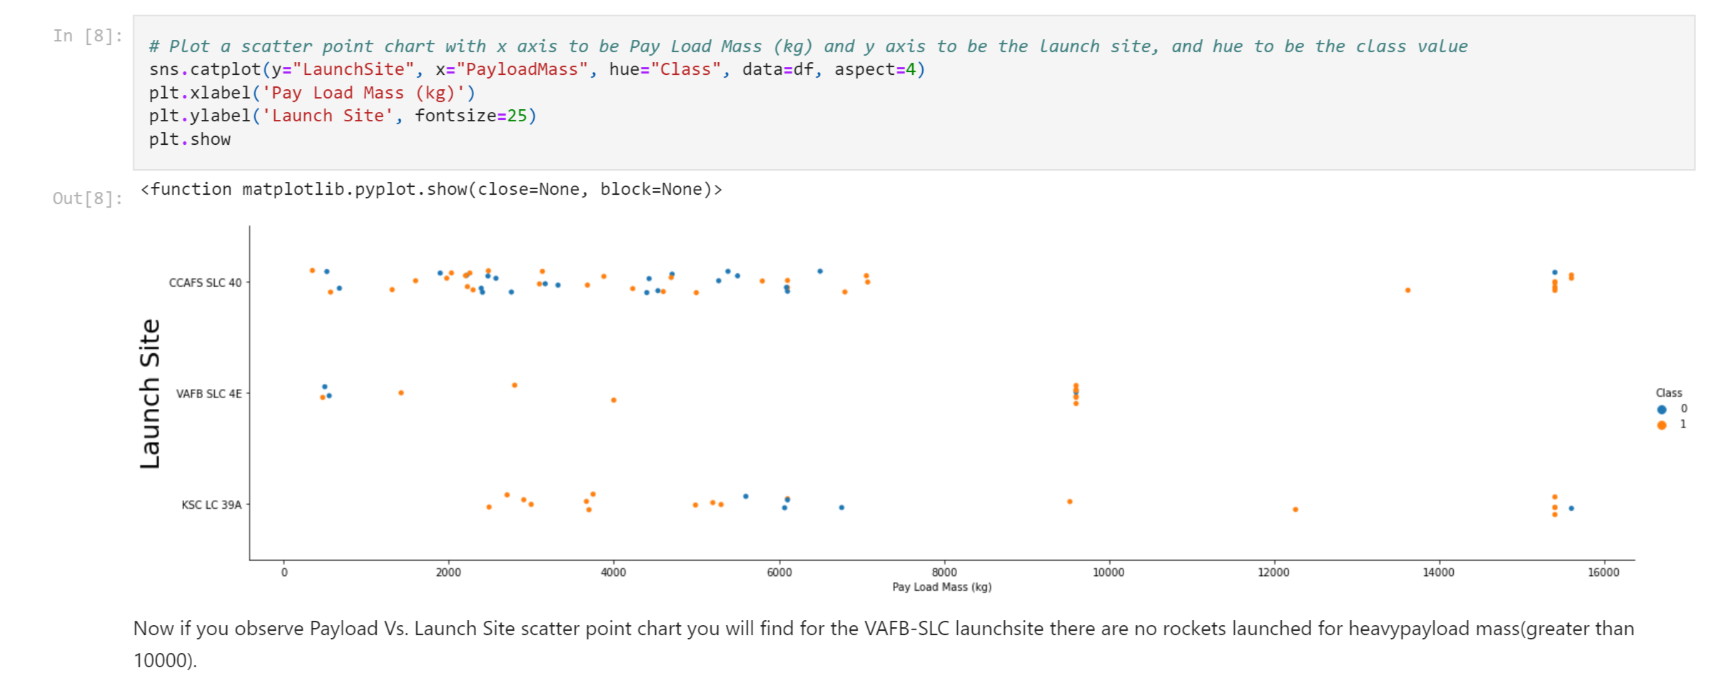
Payload vs. Launch Site

Slide 20
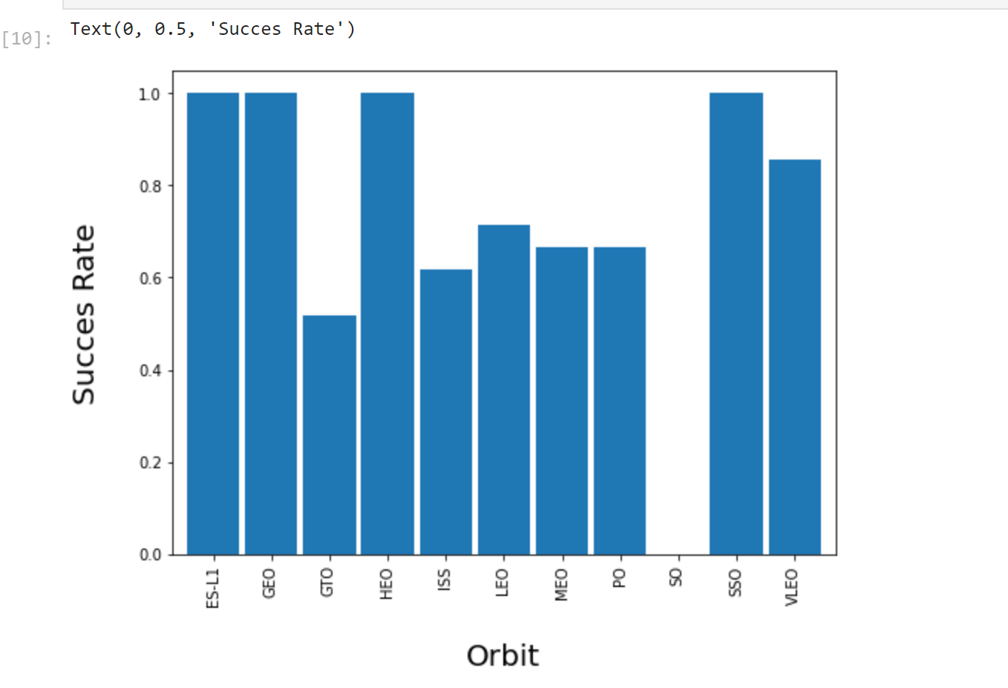
Success Rate vs. Orbit Type
Orbits ESL1, GEO, HEO &Sso has 100% success rates
Orbit SO has zero success rate
Orbits GTO, ISS, LEO, MEO and PO have similar success rates of 0.5, 0.6, 0.7, 0.65 and 0.65 respectively

Slide 21
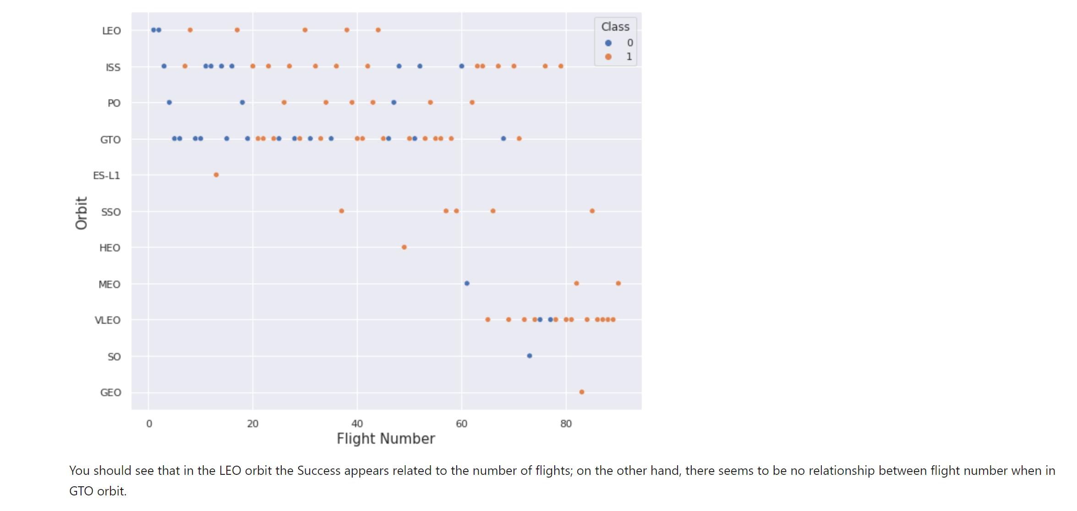
Flight Number vs. Orbit Type

Slide 22
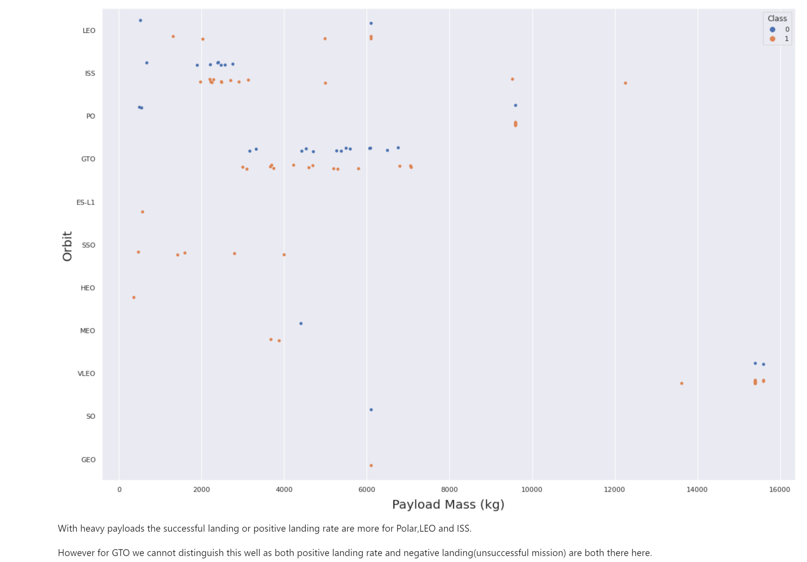
Payload vs. Orbit Type

Slide 23
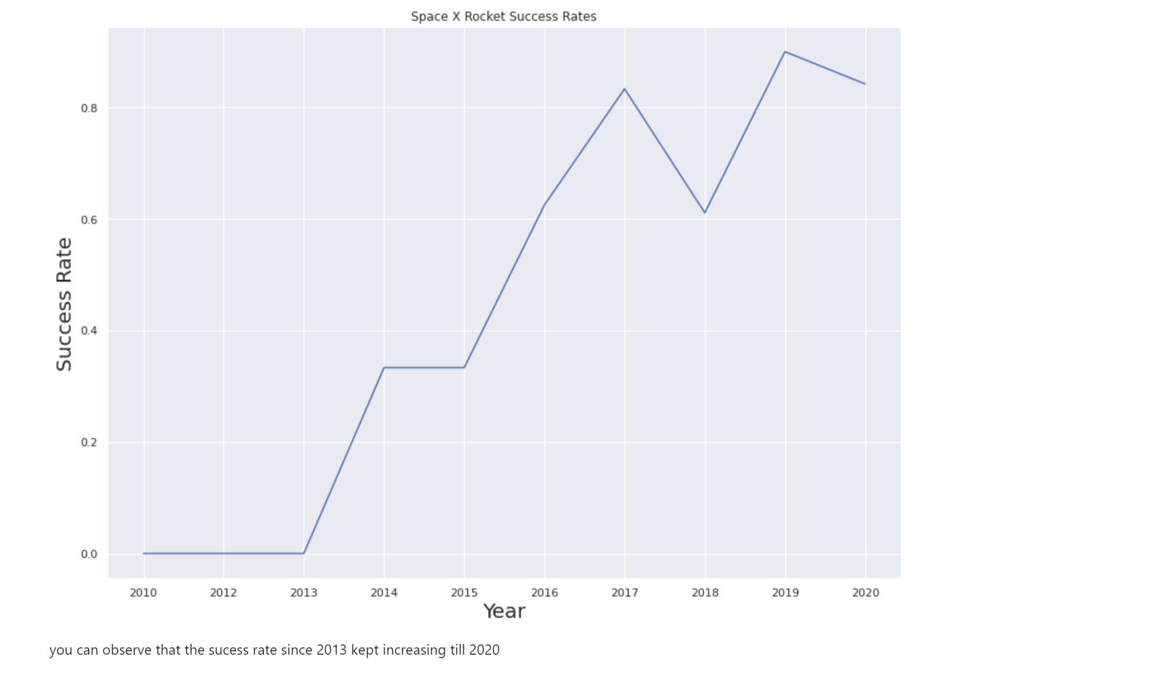
Launch Success Yearly Trend

Slide 24
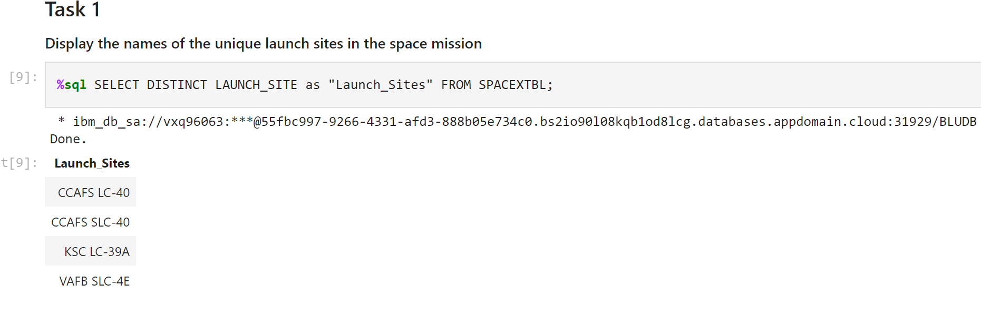
All Launch Site Names

Slide 25
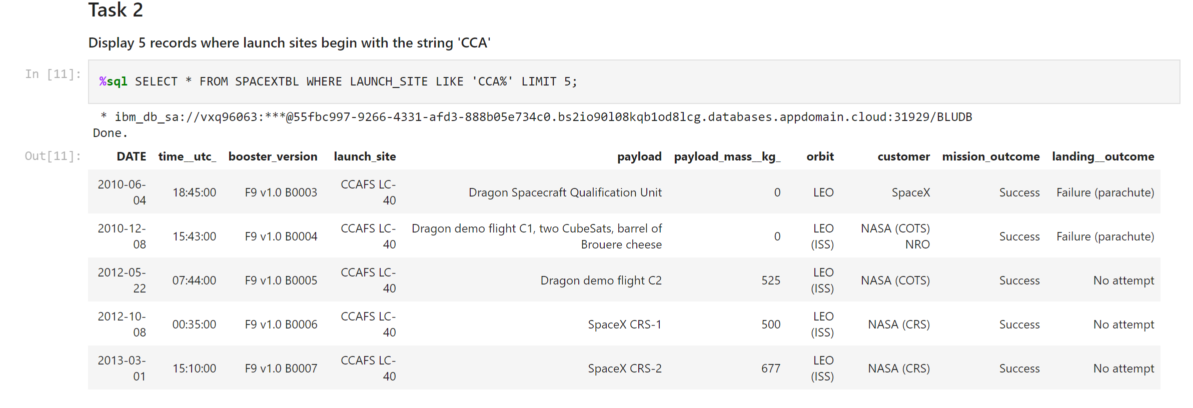
Launch Site Names Begin with 'CCA'

Slide 26
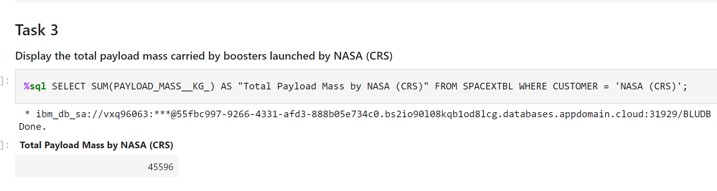
Total Payload Mass

Slide 27
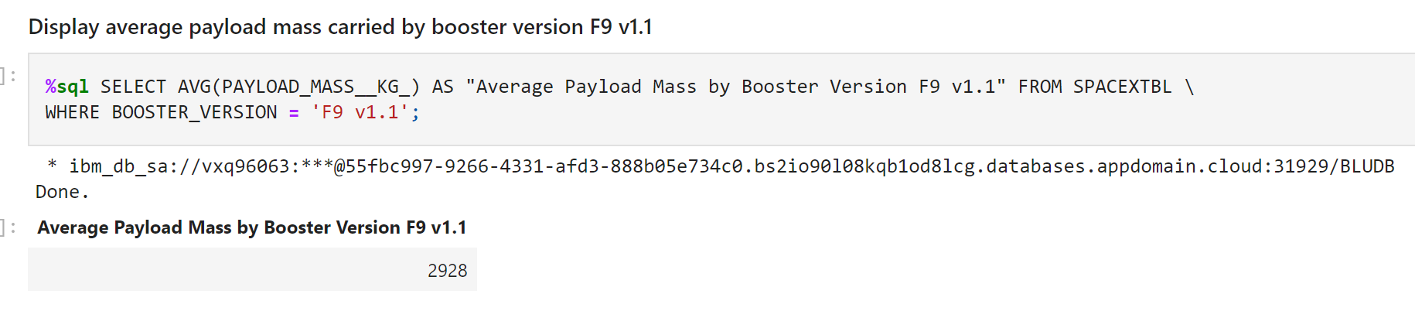
Average Payload Mass by F9 v1.1

Slide 28
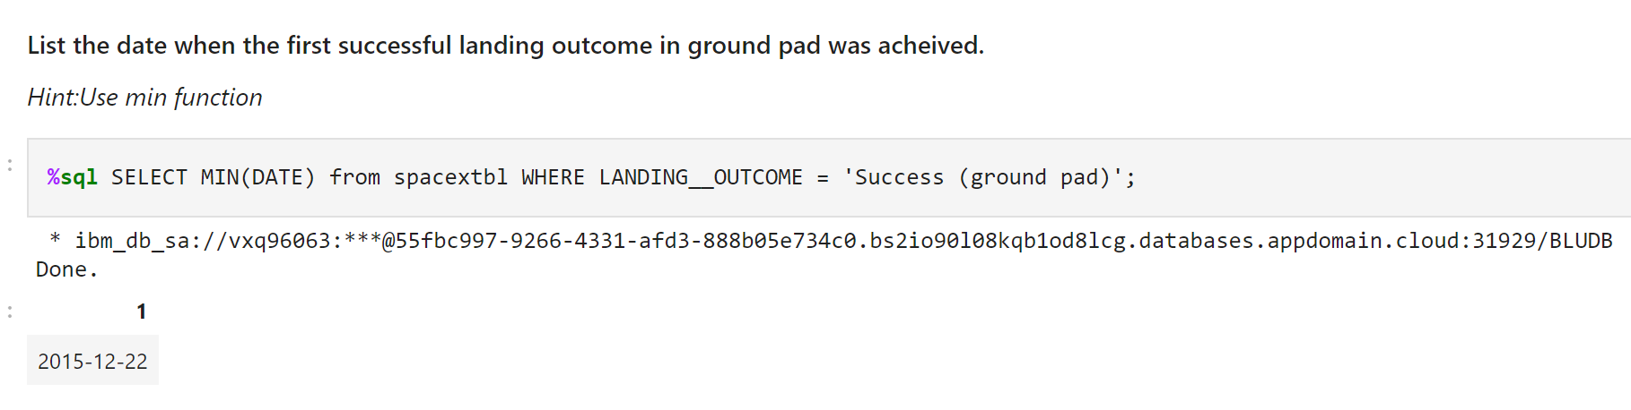
First Successful Ground Landing Date

Slide 29
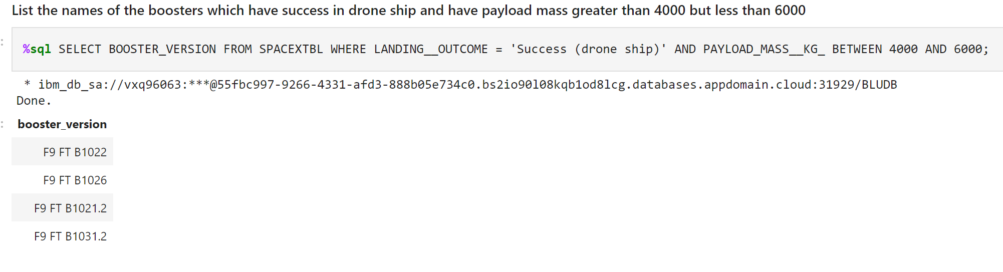
Successful Drone Ship Landing with Payload between 4000 and 6000

Slide 30
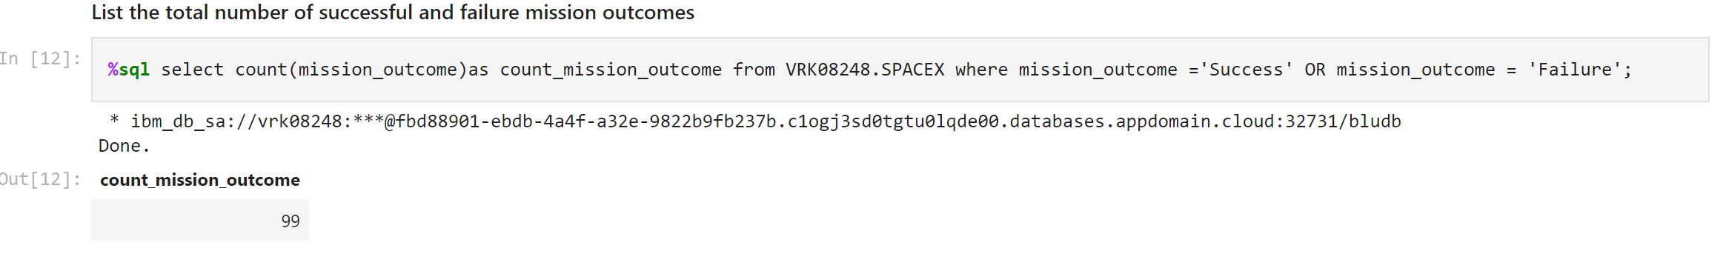
Total Number of Successful and Failure Mission Outcomes

Slide 31
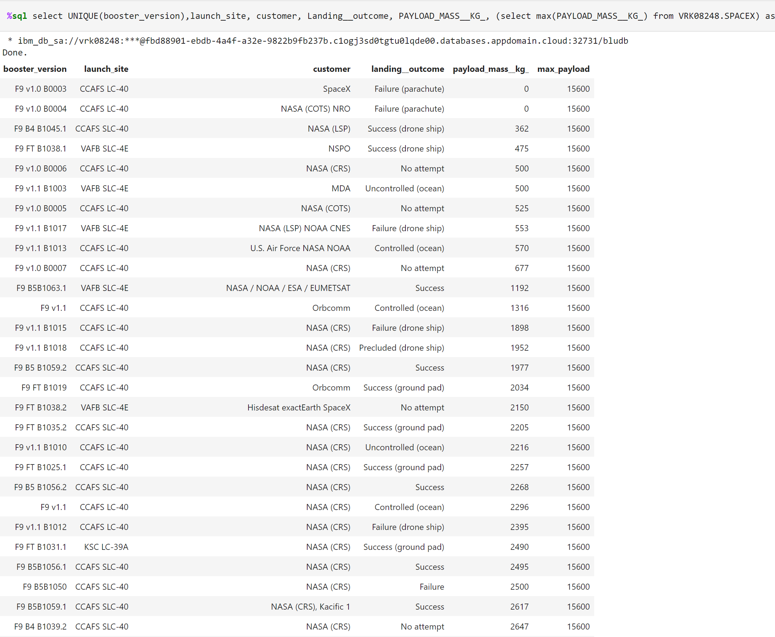
Boosters Carried Maximum Payload

Slide 32
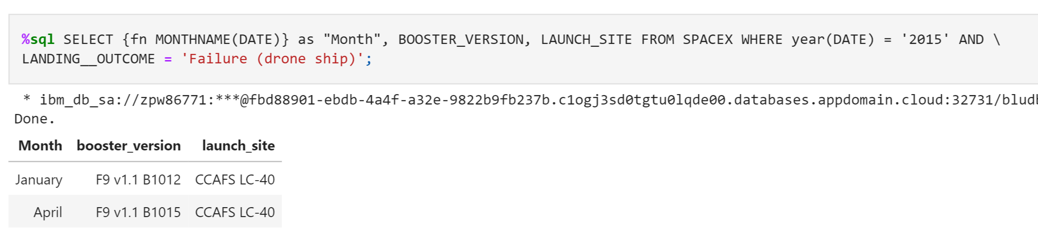
2015 Launch Records

Slide 33
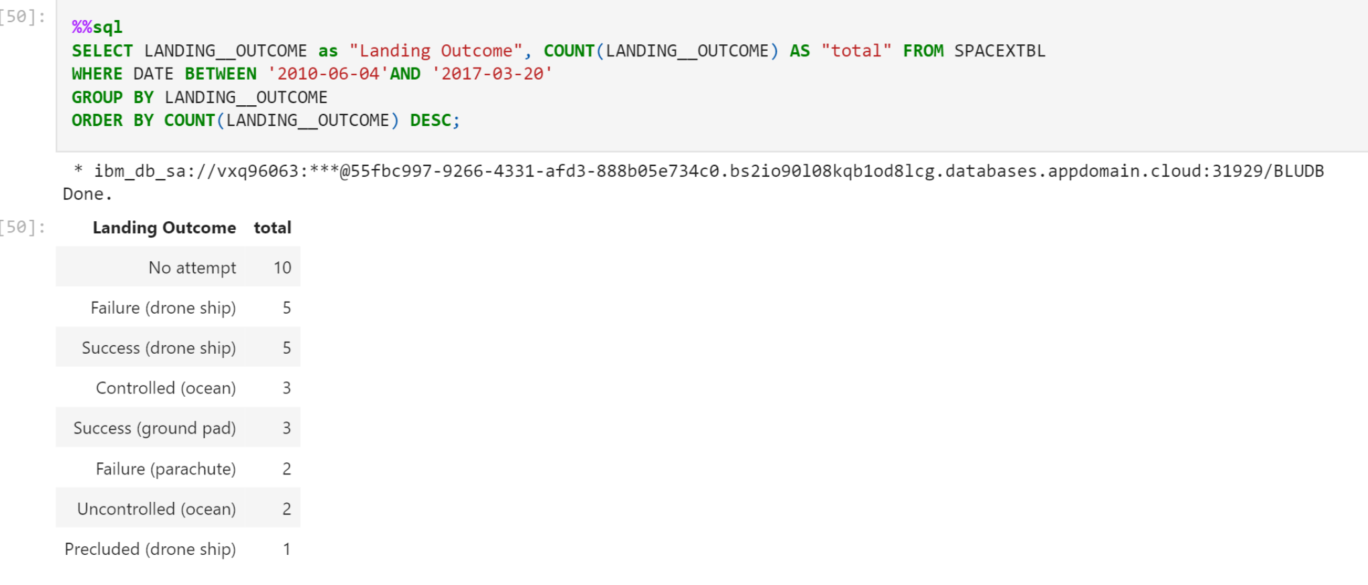
Rank Landing Outcomes Between 2010-06-04 and 2017-03-20

Slide 34


Slide 35
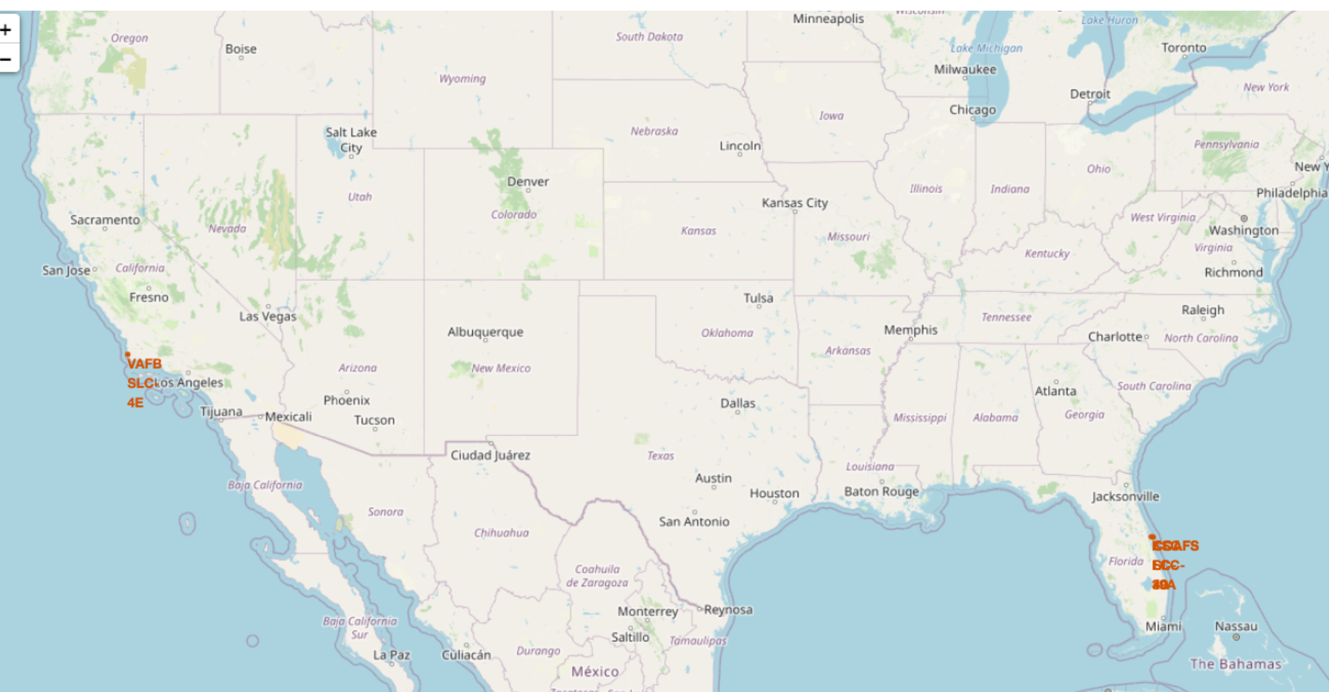
Launch Sites with Folium
All launch sites are located near to coastline, far away from populated cities, and closer to Equator

Slide 36
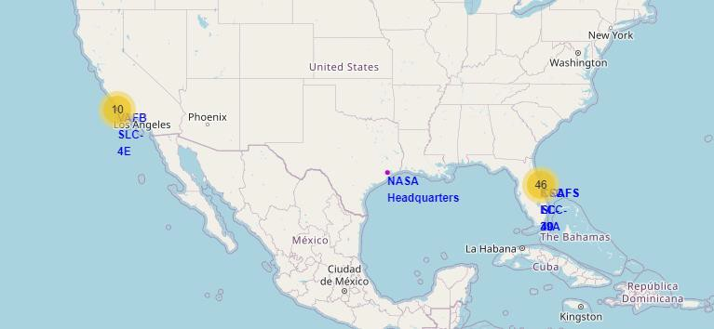
Launch Sites and Outcome using Folium
Total launches is 56 in all sites, 32 launches failed, and 24 launches succeeded

Slide 37
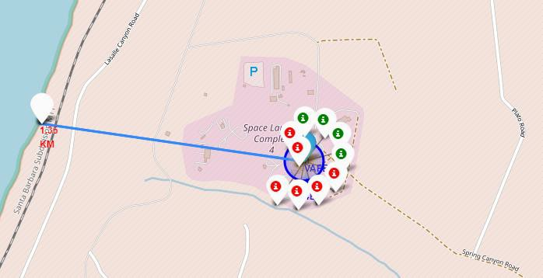
Folium Map of Site VAFB SLC-4E
Screenshot of site VAFB SLC-4E to coastline proximity with distance calculated:
the distance between launch site and coastline is 1.35 km, it has 6 failed launches and 4 succeeded launches.
37

Slide 38


Slide 39
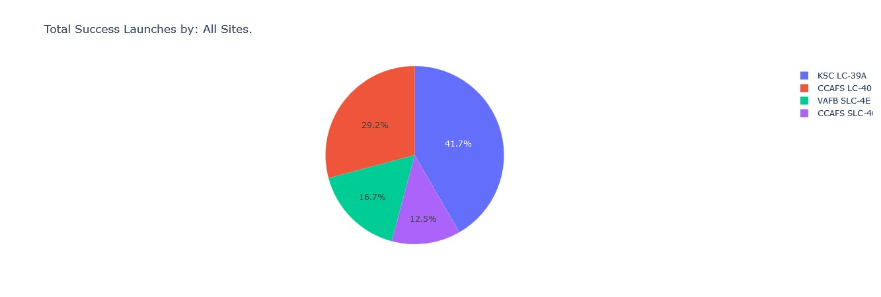
Dashboard showing All Launch Sites in Pie chart
Site KSC LC-39A has highest success rate(41.7%) followed by CCASF LC-40 , VAFB SLC-4E, while CCAFS SLC-40 has the least (12.5%)

Slide 40
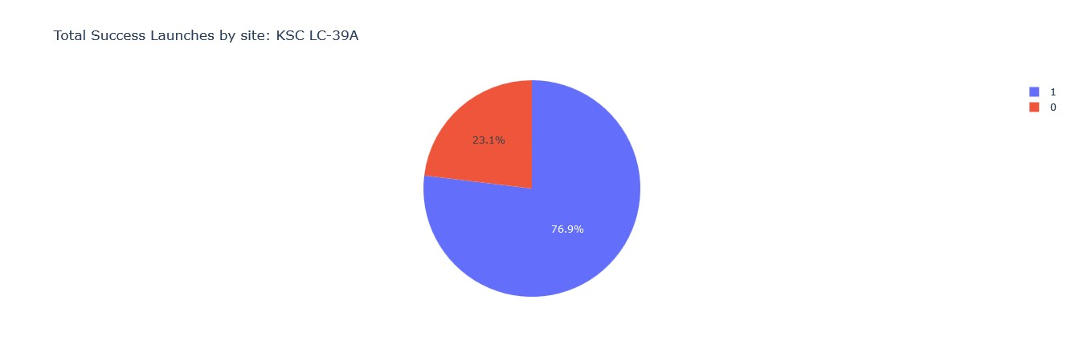
Dashboard showing Site KSC LC-39A in Pie chart
Screenshot of the launching site with highest launch success ratio:
Site KSC LC-39A has higher launching success ratio of 76.9% than any other launching site.
40

Slide 41
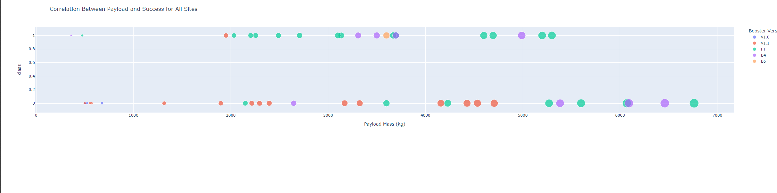
Dashboard showing All Launch Sites in Scatter Plot
Booster version: FT has higher success ratio than any other booster version.

Slide 42


Slide 43
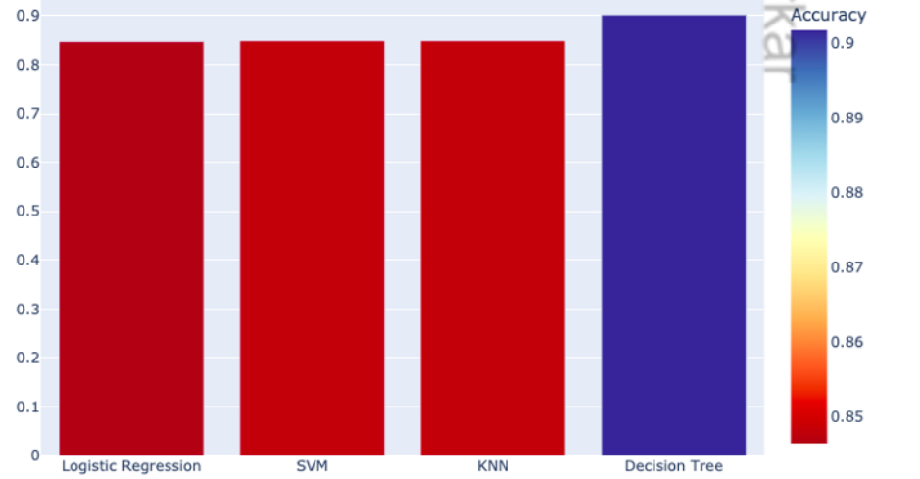
Classification Accuracy
The four different models have similar accuracies, with Decision Tree edging it out with an accuracy of 0.91

Slide 44
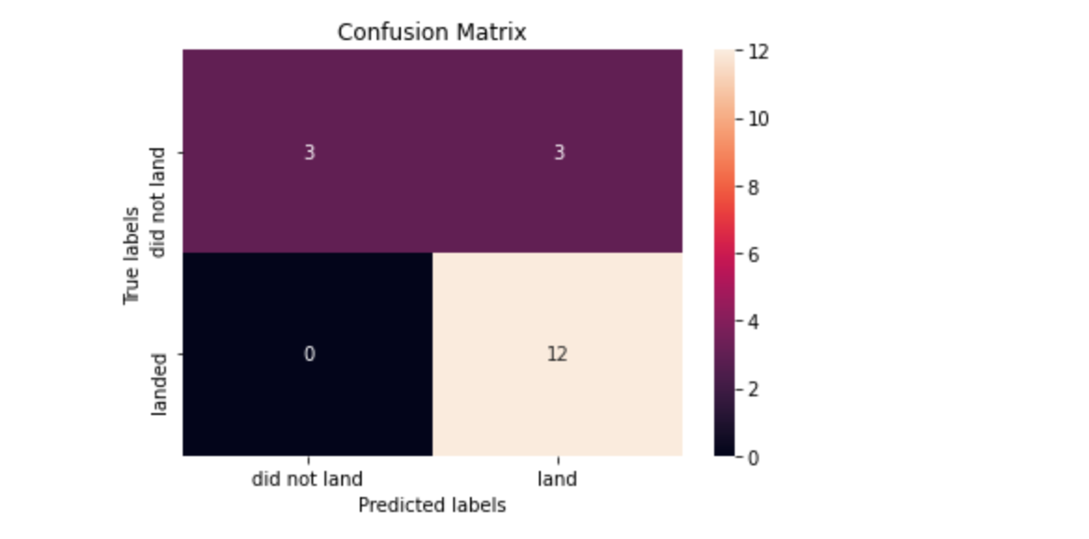
Confusion Matrix
Confusion matrix of the best performing model – the Tree model
The confusion matrix shows
12 true positves
3 false positives
3 true negatives
0 false negative

Slide 45
Conclusions
The reusability success rate for Falcon 9 is 66.67%.
More success occurred to rockets launched to ES-LI, GEO, HEO, and SEO orbits
The reusability success trends increased between 2013 to 2020.
More success occurred to rockets having booster version of FT.
More success occurred to rockets having payload mass between 1950 -5200 kg.
All launch sites have closer proximities to coastlines, Equator, and
farther away from populous cities.
It is likely that the reusability success rate for the SpaceX’s Falcon
9 will drastically increases incoming years.

Slide 46
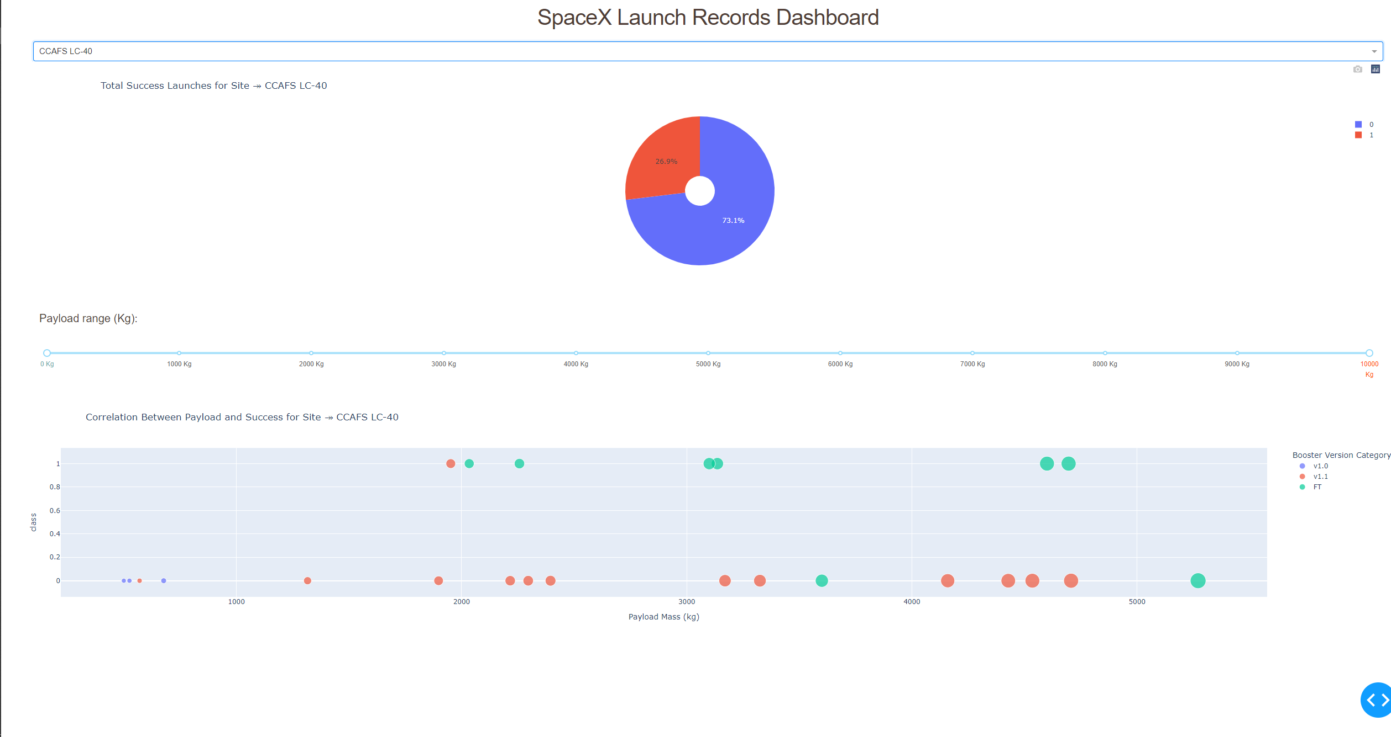
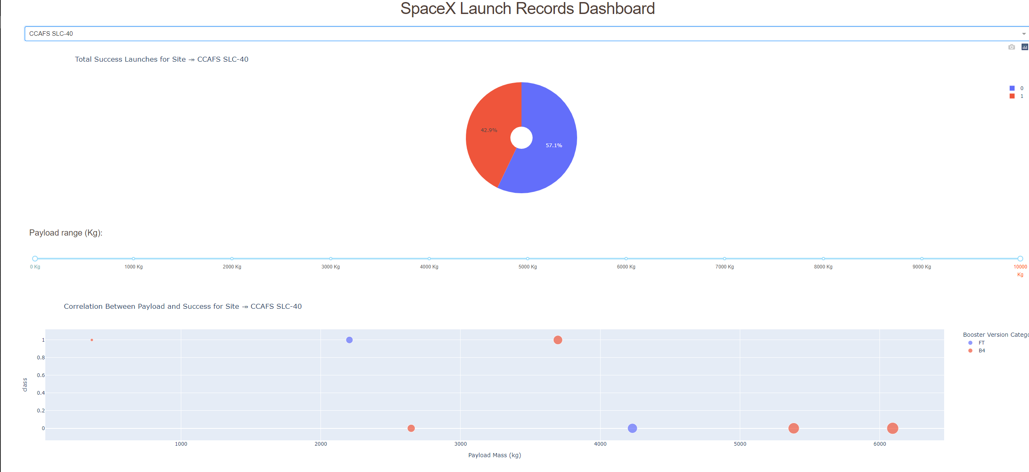
Appendix
Github repo URL link for whole project: https://github.com/atkinxx/spaceY

Slide 47


